Slide 1
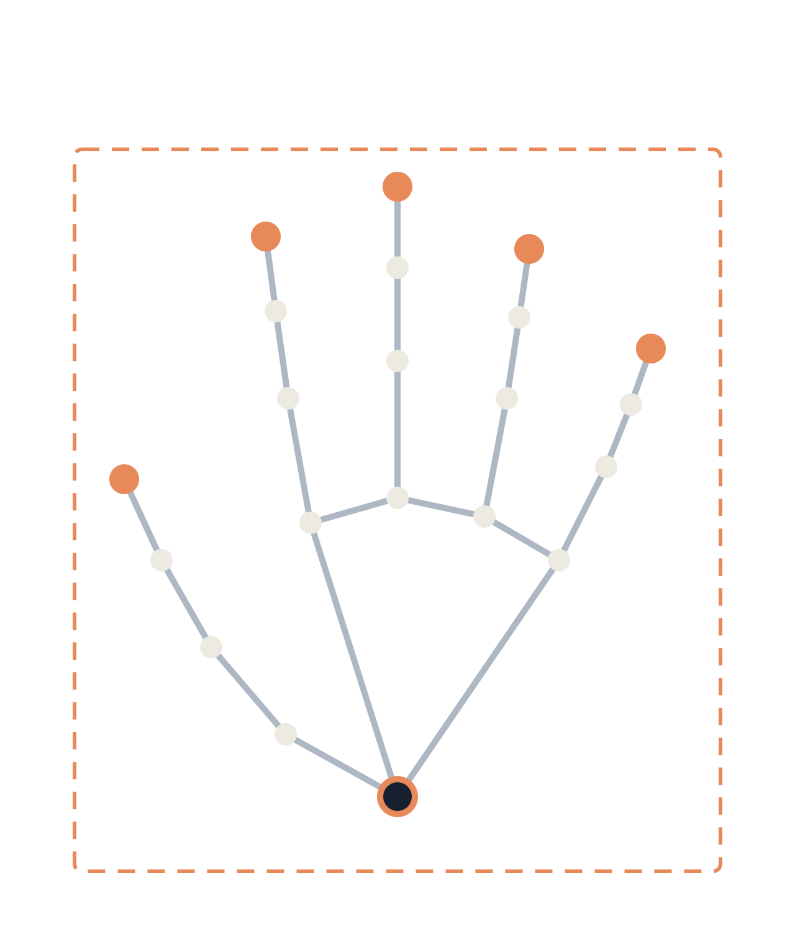
ISL-Lens
KTU B.TECH · FINAL REVIEW
Real-time Indian Sign Language recognition with open-set rejection and two-way communication
PRESENTED BY
GUIDE
INSTITUTION
Aevlin Prince
Dr. Indu John
[Department, College]
Notes:
Good morning. I am Aevlin Prince, and this is the final review of ISL-Lens, a real-time Indian Sign Language recognition and communication web application, carried out under the guidance of Dr. Indu John. The key idea of the project is that the system must know what it does not know: it recognizes supported signs and returns UNKNOWN for everything else.

Slide 2

Introduction
BACKGROUND
ISL-Lens is a web application that recognizes supported Indian Sign Language signs from a webcam and supports two-way communication between signing and speaking users.
Signing user
ISL-Lens
Speaking user
SIGN → SPEECH
Webcam video
Landmarks, model, UNKNOWN gate
Transcript and text-to-speech
SPEECH → TEXT
Speaking user
Speech recognition
Signing user
Microphone
Speech converted to text
Text in the conversation view
ISL-Lens · Aevlin Prince · Guide: Dr. Indu John
02 / 18
Notes:
ISL-Lens has two communication paths. In the sign-to-speech path, a webcam captures the signer, the recognition pipeline produces signs, and the result becomes a transcript and spoken output. In the speech-to-text path, a microphone captures the hearing user and the text appears in the conversation view. The project prioritizes measured recognition quality and honest reporting over feature count.

Slide 3
Problem Statement
BACKGROUND
A recognizer that maps every gesture to its nearest known sign will be confidently wrong.
01
02
Forced prediction
Inflated accuracy
Unsupported, incomplete or transition gestures still receive a known label.
The same signer, recording or augmented copy can leak across train and test splits.
03
04
Lab-to-webcam gap
No sentence labels
DESIGN RESPONSE
Lighting, background, distance and landmark dropouts change real-world behavior.
Isolated sign labels cannot supervise or evaluate natural English sentences.
Return UNKNOWN when unsure, and report only measured results.
ISL-Lens · Aevlin Prince · Guide: Dr. Indu John
03 / 18
Notes:
Four problems motivate the design. A closed-set classifier is forced to pick a known sign even for gestures it was never trained on. Accuracy numbers can be inflated when the same signer or recording appears in both training and test data. Performance on a clean dataset often differs from performance on a real webcam. And isolated sign labels cannot honestly train or evaluate sentence generation.

Slide 4
Objectives
BACKGROUND
01
Audit candidate datasets and build a manifest with leakage-free splits
02
Define one canonical preprocessing used by both training and live inference
03
Compare temporal models fairly on the same splits and protocol
04
Return UNKNOWN for unsupported gestures using validation-selected thresholds
05
Deliver live webcam recognition with transcript, text-to-speech and speech-to-text
06
Report dataset and real-world webcam results separately, using measured metrics only
ISL-Lens · Aevlin Prince · Guide: Dr. Indu John
04 / 18
Notes:
Six objectives, ordered the way the work is ordered: data first, then preprocessing, then models, then rejection, then the live application, and finally honest reporting. Each objective maps to a development gate that defines its own artifacts, tests and completion criteria.

Slide 5
Literature Survey
SURVEY
Work | Contribution | Role in ISL-Lens
Lugaresi et al. (2019) | MediaPipe: framework for perception pipelines | Hand, pose and face landmark extraction
Hochreiter & Schmidhuber (1997) | Long Short-Term Memory for sequences | LSTM and BiLSTM baselines
Vaswani et al. (2017) | Self-attention replaces recurrence | Temporal Transformer candidate
Yan et al. (2018) | ST-GCN: graph convolution on skeleton sequences | Graph-based candidate for hands and pose
Sridhar et al. (2020) | INCLUDE: large-scale Indian Sign Language dataset | Candidate dataset, pending audit
Open-set and calibration literature follows with the research gaps.
ISL-Lens · Aevlin Prince · Guide: Dr. Indu John
05 / 18
Notes:
The survey covers the building blocks rather than a single competing system. MediaPipe provides landmarks. LSTM, Transformer and ST-GCN families give the candidate temporal models that are compared later. INCLUDE is one candidate dataset, and it is only used if the dataset audit approves it, including its license, signer information and split availability.

Slide 6

Research Gaps and Design Response
SURVEY
GAP 1
Closed-set classifiers must always output a known sign
Open-set rejection returns UNKNOWN
Confidence, calibration, distance, energy [6]–[9]
GAP 2
Reported accuracy can be inflated by split leakage
Signer-independent splits
Automated leakage checks, both results reported
GAP 3
Isolated sign labels cannot supervise full sentences
Separate sentence stage
No sentence accuracy without paired sentences
GAP 4
Feature and model choices are rarely justified
Controlled model bake-off
Shared splits; final model chosen by evidence
ISL-Lens · Aevlin Prince · Guide: Dr. Indu John
06 / 18
Notes:
Each gap from the literature becomes a design rule. Open-set methods such as maximum-softmax-probability baselines, calibration, Mahalanobis distance and energy scores are the toolbox for the UNKNOWN decision. Leakage control and signer-independent evaluation address inflated accuracy. Sentence generation is separated from isolated recognition because the data to supervise it may not exist. The model choice is made by a controlled bake-off, not by perceived sophistication.

Slide 7


Proposed Methodology and Architecture
METHOD
01
02
03
04
05
Camera
Landmarks
Preprocessing
Sequence
Model
Frame capture
MediaPipe extraction
Canonical, shared with training
Resample, pad, mask
Spatio-temporal network
10
09
08
07
06
Speech output
Sentence layer
Committed sign
Decision engine
Open-set gate
Text-to-speech
Gloss sequence to English
One sign per gesture
Onset, stability, cooldown
Known sign or UNKNOWN
SEPARATE PATH · SPEECH TO TEXT
Microphone
Speech recognition
Text
Conversation view
ISL-Lens · Aevlin Prince · Guide: Dr. Indu John
07 / 18
Notes:
Read the top row left to right, then the second row right to left. Frames become landmarks, landmarks are normalized by one canonical preprocessing step, and a spatio-temporal model produces class probabilities. The dark boxes are the safety layer: the open-set gate decides whether the prediction is a known sign at all, and the decision engine decides whether to commit it to the transcript. Concerns are kept separate so each can be tested alone. Speech-to-text is a separate path that never touches the recognition model.

Slide 8
Methodology: Gated Development
METHOD
GATE 00 · SPEC
GATE 01 · DATA
GATE 02 · DATA
GATE 03 · MODEL
Specification
Dataset audit
Preprocessing
Baseline model
Requirements and scope documented
Manifest, splits, leakage checks
Canonical spec with unit tests
First trained reference
GATE 04 · MODEL
GATE 05 · MODEL
GATE 06 · LIVE
GATE 07 · APP
Model bake-off
Open-set rejection
Webcam inference
Web application
Candidates on one protocol
Validation-selected thresholds
Live landmarks to sign
Overlay, transcript, vocabulary
GATE 08 · LANGUAGE
GATE 09 · APP
GATE 10 · APP
GATE 11 · EVAL
Sentence generation
Two-way communication
Practice and export
Final evaluation
Only as far as data allows
Speech-to-text path
Practice mode, PDF export
Dataset and webcam reports
Each gate defines artifacts, tests and completion criteria before the next begins.
ISL-Lens · Aevlin Prince · Guide: Dr. Indu John
08 / 18
Notes:
The method is dataset-first and gate-based. Nothing is trained before the dataset audit produces a machine-readable manifest. Preprocessing is specified and tested before any model. Rejection (Gate 5) and final evaluation (Gate 11) are highlighted because they decide whether the system is trustworthy. The project does not jump ahead: each gate has its own completion criteria.

Slide 9
Implementation: Features and Preprocessing
BUILD
Candidate set | Adds
Hands only | Finger and palm shape
Both hands | Two-handed signs
Hands + pose | Arm and body context
+ face subset | Facial cues, if they help
Derived | Bone vectors, velocity, masks
Training clips
Live webcam frames
ONE SHARED MODULE
Canonical preprocessing
normalize · resample · pad · mask
Chosen by validation and signer-independent results, not by default.
Training tensors
Inference tensors
Unit tests assert equivalence
ISL-Lens · Aevlin Prince · Guide: Dr. Indu John
09 / 18
Notes:
The feature dimensionality is not fixed in advance. Hands only, both hands, hands plus pose, and hands plus pose plus a face subset are compared, along with derived features such as bone vectors and velocities. Extra landmarks are kept only if they measurably help recognition or rejection. The most important rule on this slide is on the right: training and live inference call the same canonical preprocessing, and unit tests verify that they are mathematically equivalent.

Slide 10
Implementation: Model Bake-off
BUILD
Candidate | What it captures
SVM baseline | Reference, no temporal modelling
Temporal CNN | Local motion across frames
LSTM / BiLSTM | Frame order, both directions
BiLSTM + Attention | Focus on informative frames
Temporal Transformer | Long-range temporal attention
ST-GCN | Joint-graph structure
ST-GCN + Transformer | Graph structure plus global timing
SHARED BY EVERY CANDIDATE
Same splits
Same preprocessing
Same evaluation protocol
LOGGED PER EXPERIMENT
Experiment and split IDs
Seed and hyperparameters
Software and hardware
Latency and model size
Final model is chosen from evidence, not sophistication.
ISL-Lens · Aevlin Prince · Guide: Dr. Indu John
10 / 18
Notes:
BiLSTM with attention was the original proposal, but it is now one candidate among seven. Every candidate trains on the same splits with the same preprocessing and is scored by the same protocol, and every run is logged with its seed, configuration, latency and model size. Old experiments are never overwritten. The final model comes from this evidence.

Slide 11
Implementation: Rejection and Decisions
BUILD
REJECTION SIGNALS TO EVALUATE
RETURNS UNKNOWN FOR
Calibrated confidence
Top-1 and top-2 margin
Energy score
Embedding or centroid distance
Mahalanobis distance
Unsupported or incomplete signs
Transitions and resting hands
Random or non-sign movement
Poor landmark detection
Ambiguous, similar-looking gestures
Thresholds come from validation data, never the test set.
TEMPORAL DECISION ENGINE
Sign onset
Stable prediction
Commit once
Cooldown
HELLO HELLO HELLO HELLO
HELLO UNKNOWN GO UNKNOWN
Commits one HELLO, not four
Merged only if completed signs are valid
ISL-Lens · Aevlin Prince · Guide: Dr. Indu John
11 / 18
Notes:
Open-set rejection is mandatory. A gesture outside the supported vocabulary is never mapped to the closest known sign. Several rejection signals are compared, and the thresholds are learned or selected on validation data only. Above the model, a temporal decision engine controls what reaches the transcript: it waits for sign onset and stability, commits once, then applies a cooldown to suppress duplicates. This engine is tested separately from the recognition model.

Slide 12
Implementation: Web Application
BUILD
ISL-LENS
TRACKING OK · 2 HANDS
PROJECT STRUCTURE
WEBCAM + SKELETON
CURRENT SIGN
src/landmarks · preprocessing
src/models · rejection · decision
app/backend · templates · static
sentence/ · tests/ · configs/
data/ · experiments/ · reports/
UNKNOWN
RAW SIGNS
Transcript
Inside usable region
SENTENCE
Generated English
DESIGN RULES
Model logic stays out of HTML
Vocabulary is configuration-driven
Runtime can change without a UI rewrite
HEARD · SPEECH-TO-TEXT
Message from the hearing user
Speech out
Vocabulary
Practice
PDF export
Raw signs, sentences and heard speech are shown separately.
ISL-Lens · Aevlin Prince · Guide: Dr. Indu John
12 / 18
Notes:
The left side is a layout sketch of the interface, not a screenshot. The skeleton overlay is functional: it shows tracking status, hand visibility and whether the signer is inside the usable camera region. UNKNOWN is an explicit state. Raw recognized signs, generated sentences and speech-to-text from the hearing user are kept visually separate so the interface never implies more certainty than the system has. On the right, recognition logic lives in dedicated source modules, Flask serves the app and APIs, and the inference runtime (TensorFlow.js, ONNX Runtime Web or backend) is still open, to be decided from accuracy, latency and size evidence.

Slide 13
Results and Discussion: Protocol and Targets
RESULTS
Metric | Target | Measured
Top-1 accuracy | > 90% | 93.0% (120/129)
Top-3 accuracy | > 97% | 97.7% (126/129)
False positive rate | < 8% | N/M
Inference per frame | < 60 ms | N/M
Sign-to-speech latency | < 300 ms | N/M
SUS usability score | > 75 | N/M
ALSO REPORTED
Macro F1: 91.2%
Weighted F1: 92.5%
129 held-out clips · 36 labels
Per-class report + confusion matrix saved
OPEN-SET
FPR / FAR / FRR: not measured
Unknown rejection: not measured
AUROC / AUPR: not measured
Top-1/Top-3: same-corpus holdout only (129 clips); not webcam or signer-independent results.
ISL-Lens · Aevlin Prince · Guide: Dr. Indu John
13 / 18
Notes:
Fill the Measured column from the experiment records before presenting. The Target column holds the roadmap goals, and they must not be shown as achieved results. Results are reported on both a standard benchmark split and a signer-independent split where signer metadata allows, and any difference between them is discussed. Rejection thresholds were selected on validation data, so the test set is used once for the final numbers.
Evidence: reports/experiments/isl40_landmark_logreg_report.json. Stratified random holdout (seed 42), 129 held-out clips from 642; 36 labels. Top-1 120/129 (93.0%), Top-3 126/129 (97.7%), macro F1 91.2%, weighted F1 92.5%. The 100 user-taught exemplars were included in training and excluded from scoring. This is a same-corpus estimate, not signer-independent or webcam performance. N/M means not measured.

Slide 14
Results and Discussion: Webcam Testing
RESULTS
Environment
Signer
Gesture
Lighting variation
N/M
Multiple signers
N/M
Partial signing
N/M
Background variation
N/M
Left and right hand
N/M
Transitions
N/M
Camera distance
N/M
Slow signing
N/M
Pauses
N/M
Hand position
N/M
Fast signing
N/M
Unsupported gestures
N/M
Clothing
N/M
Visually similar signs
N/M
HOW RESULTS ARE READ
No controlled webcam trials were recorded; all 14 listed conditions remain unmeasured.
ISL-Lens · Aevlin Prince · Guide: Dr. Indu John
14 / 18
Notes:
Fill each bracket with the measured webcam result for that condition before presenting. These fourteen conditions come from the evaluation plan: environment, signer and gesture variations. Dataset accuracy alone is not enough, because the live system faces lighting changes, different signers, transitions and gestures outside the vocabulary. Correct rejection of unsupported gestures is reported as a success, since a confident wrong prediction is worse than UNKNOWN.
No controlled webcam evaluation log was present in the project records. N/M means not measured; the 14 listed conditions are test scenarios, not completed trials. Do not interpret the corpus holdout metrics as webcam accuracy.

Slide 15
Conclusions
CLOSE
01
The browser prototype recognizes 48 trained sign classes.
GUIDING PRINCIPLES
Accuracy > feature count
02
On a stratified same-corpus holdout, Top-1 was 93.0% and Top-3 was 97.7%.
Correct rejection > confident wrong prediction
03
Live-webcam and signer-independent accuracy remain unmeasured.
Real-world signer-independent performance > training accuracy
04
Sentence output is rule-based; translation accuracy has not been measured.
Measured evidence > assumptions
Clean architecture > quick hacks
ISL-Lens · Aevlin Prince · Guide: Dr. Indu John
15 / 18
Notes:
The conclusion is about method as much as outcome. The project is built so that every claim can be checked: the dataset is audited, the preprocessing is tested, the models are compared fairly, unsupported gestures are rejected, and real-world webcam testing is reported separately. Add one sentence here summarizing your actual measured results from the previous two slides. The five principles on the right guided every design decision.
Actual measured result: 93.0% Top-1 (120/129) and 97.7% Top-3 (126/129) on a stratified random holdout from the same corpus. Live-webcam and signer-independent performance were not measured. Source: reports/experiments/isl40_landmark_logreg_report.json.

Slide 16
Limitations and Risks
CLOSE
Limitation | Mitigation
Few public ISL datasets cover 100+ signs | Dataset audit sets the supported vocabulary
Signer metadata may be missing | Signer-independent claims only with metadata
Landmarks can drop on real webcams | Tracking overlay and webcam test matrix
Similar signs need more data | Class analysis; low margin gives UNKNOWN
Sentences need paired training data | No sentence accuracy claimed without it
Interface could imply false certainty | Explicit UNKNOWN state; honest practice score
Claims are limited to what was measured.
ISL-Lens · Aevlin Prince · Guide: Dr. Indu John
16 / 18
Notes:
These are the main risks identified in the specification, each paired with its mitigation. The supported vocabulary depends on what legitimate data exists. Signer-independent evaluation depends on signer metadata. Real webcam conditions can degrade landmark detection. Sentence generation cannot be evaluated without ground-truth sentences. Add any limitation you observed during your own testing.

Slide 17

Future Scope
CLOSE
NEXT · DATA AND DEPLOYMENT
THEN · LANGUAGE
LATER · PLATFORM
Grow the vocabulary toward 100+ signs as legitimate data allows
Collect paired video, gloss and English data
WebRTC for remote conversations
Federated learning for privacy-preserving updates
Choose the runtime: TensorFlow.js, ONNX Runtime Web or backend
Train and evaluate sentence generation
Offline-capable browser inference
Add LLM grammar correction
Run a SUS usability study
Every new sign needs legitimate data, a vocabulary update, retraining and re-evaluation.
ISL-Lens · Aevlin Prince · Guide: Dr. Indu John
17 / 18
Notes:
Future work follows dependencies, not dates. Vocabulary growth and the deployment runtime decision come first because they depend only on data and measurement. Sentence generation and grammar correction follow once paired data exists. WebRTC and federated learning come from the original roadmap and are the longest-term items. A new sign is never added by mapping it to the nearest known sign: it needs real data, an updated vocabulary, retraining and re-evaluation.

Slide 18
References
CLOSE
Q & A
[1] C. Lugaresi et al., “MediaPipe: A Framework for Building Perception Pipelines,” arXiv:1906.08172, 2019.
Questions?
[2] S. Hochreiter and J. Schmidhuber, “Long Short-Term Memory,” Neural Computation, 1997.
Thank you for listening.
[3] A. Vaswani et al., “Attention Is All You Need,” NeurIPS, 2017.
[4] S. Yan, Y. Xiong and D. Lin, “Spatial Temporal Graph Convolutional Networks for Skeleton-Based Action Recognition,” AAAI, 2018.
[5] A. Sridhar et al., “INCLUDE: A Large Scale Dataset for Indian Sign Language Recognition,” ACM Multimedia, 2020.
[6] D. Hendrycks and K. Gimpel, “A Baseline for Detecting Misclassified and Out-of-Distribution Examples in Neural Networks,” ICLR, 2017.
[7] C. Guo et al., “On Calibration of Modern Neural Networks,” ICML, 2017.
[8] K. Lee et al., “A Simple Unified Framework for Detecting Out-of-Distribution Samples and Adversarial Attacks,” NeurIPS, 2018.
PRESENTED BY
[9] W. Liu et al., “Energy-based Out-of-distribution Detection,” NeurIPS, 2020.
Aevlin Prince
GUIDE
Dr. Indu John
ISL-Lens · Aevlin Prince · Guide: Dr. Indu John
18 / 18
Notes:
References [1] to [5] support the pipeline, candidate models and dataset. References [6] to [9] support the open-set and calibration methods behind UNKNOWN. Please verify the citation details against the original papers before submission. Thank the panel and Dr. Indu John, then take questions.

